Slide 1

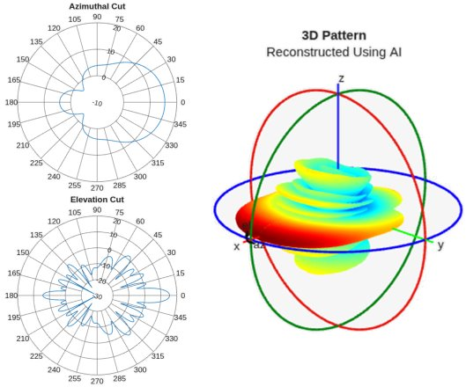
AP-S/URSI — Technical Workshop HD-7
AI in Antenna Design and Analysis: From
Pretrained Models to System-Level Integration
Part 2 — Pattern Reconstruction with AI
Sudarshan Sivaramakrishnan – ssivaram@mathworks.com
Principal Software Engineer
MathWorks | RF/EM Group
Notes:
Build the RF digital twin of a beamformer from OTA measurements and with hardware knowledge coming from the datasheet.
Use the digital twin for system-level integration and exploration of different applications.
This work is based on the model of the Fujikura Type-C PAAM integrated beamformer:
MW96-11-22-0008(11)_Type-C_Brochure.pdf

Slide 2
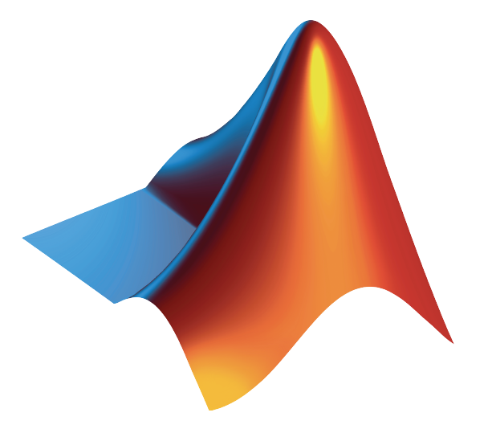
Antenna Workflows #2: Importing Data
Import
Post
process
Antenna Design
EM
Integrate
Export
Notes:
If the antenna lifecycle often starts with EM analysis, in most cases it involves dealing with data, results coming from EM tools, or from measurements.

Slide 3
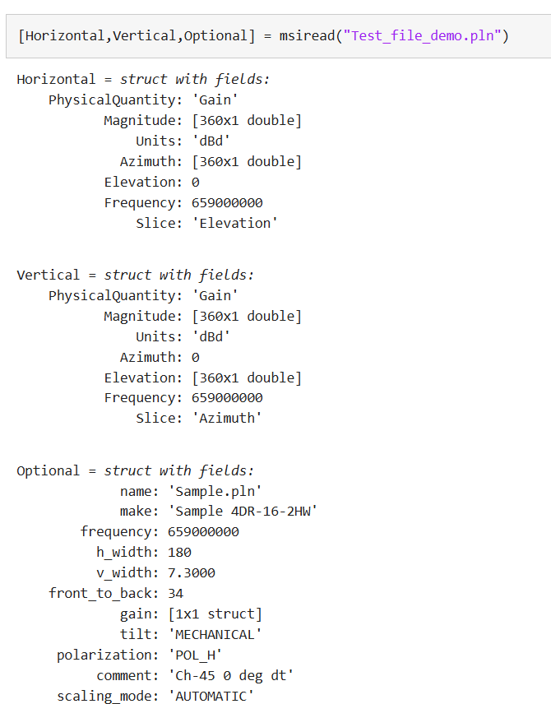

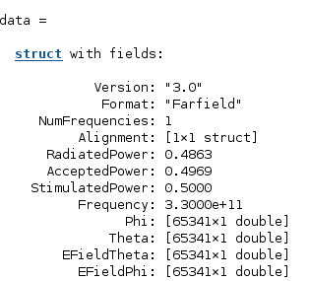
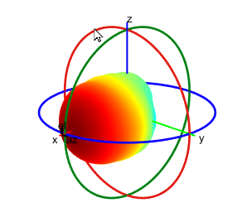
Importing Patterns – File Readers
File Formats
.CSV
.MSI, .PLN
.FFS (CST)
.FFD (Ansys)
Query on struct/object
Visualize using
polarpattern
patternCustom
Notes:
If data in the form of radiation patterns is what you have, either provided by a colleague, a customer, or a supplier, you can import it MATLAB.
Importing data in MATLAB is not rocket science, we have all done it, for example reading CSV files.
What is maybe more interesting is that you can import richer formats such as MSI, planet, FFS, and FFD.
The data is directly used to populate a structure such as the ones shown here, that can be interrogated or visualized without any additional post processing.

Slide 4
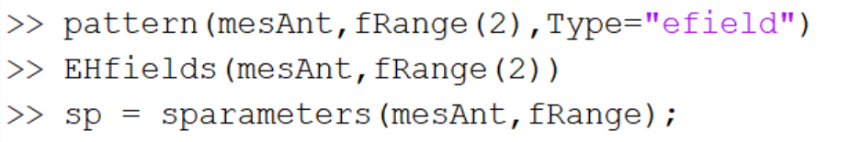
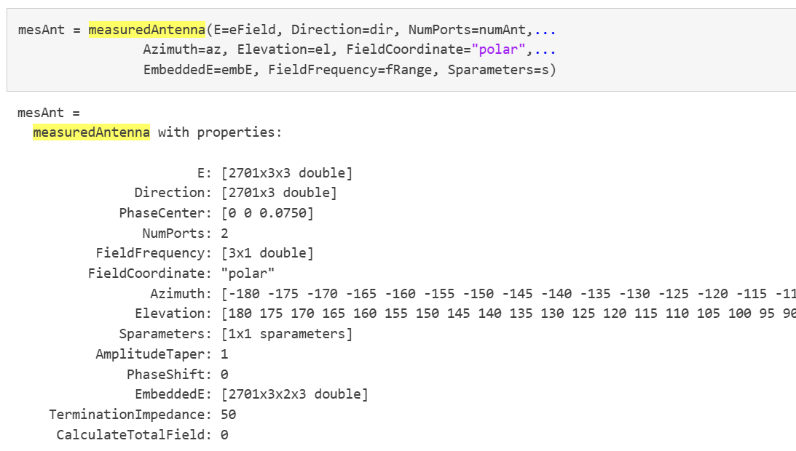
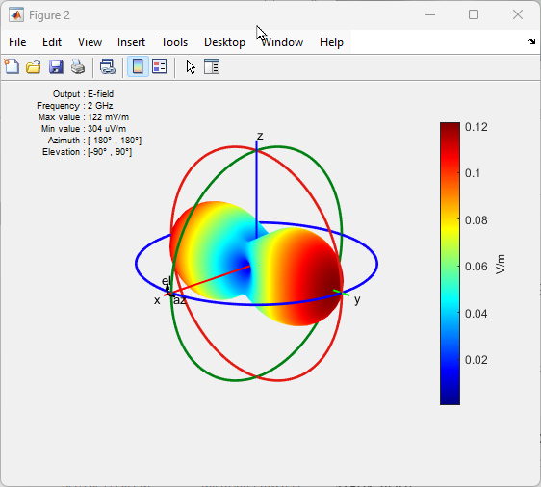
Using Antenna Data: Introducing the Measured Antenna Object
Import antenna data: from measurements or 3rd party EM tools
S-parameters
E-field of (embedded) element
Direction: No. of observation points (Px3)
FieldFrequency: No. of frequency points (F)
NumPorts: Number of feeds (N)
E: P x 3 x F
EmbeddedE: P x 3 x N x F
Sparameters: N-port s-parameters object
Notes:
The imported data can then be used to create the measuredAntenna object.
Think of it as container that stores not only the pattern but also the S-parameters of the antenna or array.
This means that the measured antenna object can actually contain A LOT of data.
<click>
For example, for array it can contain the 3D pattern over XYZ locations, at different frequencies, and for each array element.
<click>
Once your data is stored into the measured antenna object, you can interrogate it as you would do with an antenna object analyzed with EM techniques.
This is very helpful, as you can use the same code, and for example apply the function pattern or sparameter either to an antenna designed and analyzed with MoM, or to data that has been imported from measurements.
This streamlines the workflow, improves efficiency, facilitates comparisons, making it simple to identify and debug issues.

Slide 5
Antenna Workflows #2: Importing Data with AI
Import
Post
process
AI
Antenna Design
EM
Integrate
Export
Do you have access to partial antenna data?
Do you need to integrate antennas at the system-level?
Do you need to speed up antenna measurements?
Notes:
But what if you have access to partial, limited, antenna data?
Do you need to integrate antennas at the system-level?
Do you need to speed up antenna measurements?

Slide 6
What if my Pattern is not Complete? Can you reconstruct the full (3D) pattern?
Notes:
For example, if for whatever reasons you only have a partial pattern, such as the 2 slices shown here, and you want to integrate your antenna into beamforming simulation, can you reconstruct the full 3D pattern?
Even just mentally this is a challenging exercise.

Slide 7
What if my Pattern is not Complete?
Motivation for reconstructing 3D radiation patterns:
Enable system designers working with antenna datasheets (partial data)
Reduce the number of measurement samples
?
Notes:
There might be different reasons why you oly have a partial pattern.
For example, you only have access to the datasheet of the antenna.
Or a limited set of results from EM analysis.
Or limited measurements , maybe because your handler has limited mobility, or maybe because you wanted to save some tine.

Slide 8
What if my Pattern is not Complete? 3D Pattern Reconstruction
Reconstruct patterns starting from 2 (orthogonal) slices:
Analytical methods: patternFromSlices
Deep learning based prediction: patternFromAI
3D
Pattern Reconstruction
https://www.mathworks.com/help/antenna/ref/patternfromai.html
https://www.mathworks.com/help/antenna/ref/patternfromslices.html
Notes:
If you only have 2 slices of data, you can rebuilt the 3D pattern either using analytical methods, or using artificial intelligence.
MATLAB provides different analytical interpolation techniques. I am not going to talk about it today, because I am going to show you the AI-based solution that actually provides far better results.

Slide 9
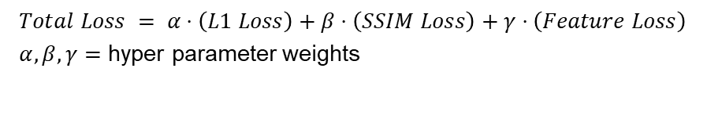
AI-Enabled Pattern Reconstruction – Overview
3D
2D Slices
Why AI?
Improve the accuracy of the reconstructed 3D pattern
Overcome limitations of analytical approaches with no assumptions on input data format
Training Process
Generator learns to predict 3D pattern given slices
Custom loss function to compare against ground truth
L1: mean absolute error
SSIM: structural similarity
Feature-based loss
Training data: ~100,000 unique patterns (EM simulation)
Single port antennas: omni / semi / highly-directional
Array configuration: linear, circular, rectangular
Classic image augmentations: noise, transformations
Generator
Autoencoder
Reconstructed Pattern
Distance between bottleneck activations
$$Total Loss = α⋅\left(L1 Loss\right)+β⋅\left(SSIM Loss\right)+γ⋅\left(Feature Loss\right)$$
$α,β,γ=$ hyper parameter weights
P. J. DiMeo, S. Sivaramakrishnan and V. Iyer, "AI-Based 3D Antenna Pattern Reconstruction," 2024 IEEE International Symposium on Antennas and Propagation and INC/USNC‐URSI Radio Science Meeting (AP-S/INC-USNC-URSI), Firenze, Italy, 2024, pp. 1-2, doi: 10.1109/AP-S/INC-USNC-URSI52054.2024.10686954.
Notes:
If you think about it, this is a perfect problem where AI can really bring benefit.
In a way, it is not very dissimilar from an image reconstruction problem, where AI is already and effectively broadly used.
Using AI you can improve over analytical techniques, and you can also reduce the limited set of assumptions that are required for analytical methods.
https://www.mathworks.com/help/images/image-quality-metrics.html
https://www.mathworks.com/help/images/ref/multissim.html
So with MATLAB Antenna Toolbox we have generated lots if antenna patterns, actually more than 100,000 for single antennas, arrays, and even , sliced it in 2D, used this synthetic data to train a NN to reconstruct the 3D pattern.
We trained convolutional neural network with an auto-encoder that uses a custom loss function that determines bottles necks for activations, in other words, a measurement of how good the NN prediction is compared to reality. The custom loss function, and here is the special sauce of AI, uses the absolute error, structural similarity, and perceptual feature-based loss.
Perceptual loss captures antenna specific features. Comparing activations at the bottleneck will guide us toward a more perceptually similar generated pattern.

Slide 10
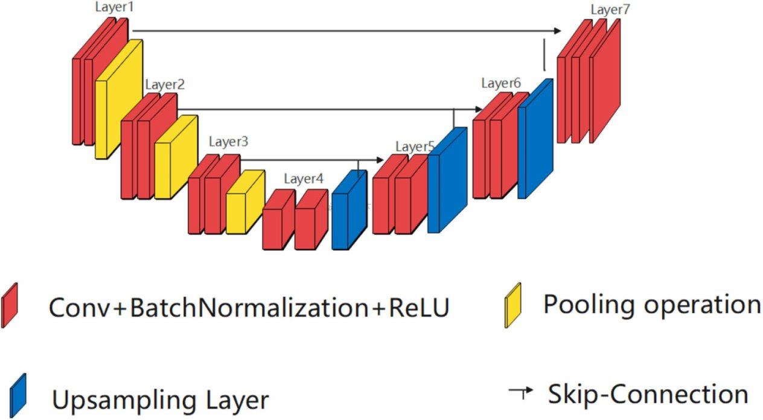
AI-Enabled Pattern Reconstruction – Generator Architecture
Generative model similar to multi-sequence-to-image convolutional neural network (CNN) with a U-Net backbone [1]
Construct sequence
Expand 1D data to 2D
Generate Pattern Via UNet
1D Conv
Permute + Stack at channel
1D Conv
[1] V. Ghodrati, J. Shao, M. Bydder, Z. Zhou, W. Yin, K. L. Nguyen, Y. Yang, and P. Hu, "MR image reconstruction using deep learning: evaluation of network structure and loss functions," Quant Imaging Med Surg. vol. 9, no. 9, pp. 1516-1527, Sep. 2019. doi: 10.21037/qims.2019.08.10.
[2] S. Cai, Y. Wu, and G. Chen, "A Novel Elastomeric UNet for Medical Image Segmentation," Front. Aging Neurosci., vol. 14, p. 841297, Mar. 2022. [Online]. Available: https://doi.org/10.3389/fnagi.2022.841297
Notes:
Talk about generator, add block diagram

Slide 11
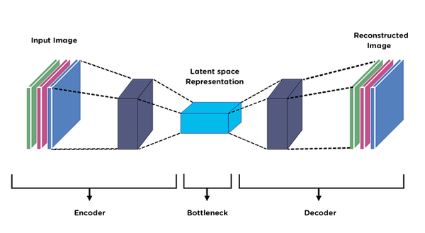
AI-Enabled Pattern Reconstruction – Feature Loss Autoencoder
Custom-trained auto-encoder for (perceptual) feature-based loss
Perceptual loss captures antenna specific features
Bottleneck activations serve as the semantic representation
Comparing activations at the bottleneck will guide us toward a more perceptually similar generated pattern.
Generated
Ground Truth
[1] https://medium.com/@birla.deepak26/autoencoders-76bb49ae6a8f

Slide 12
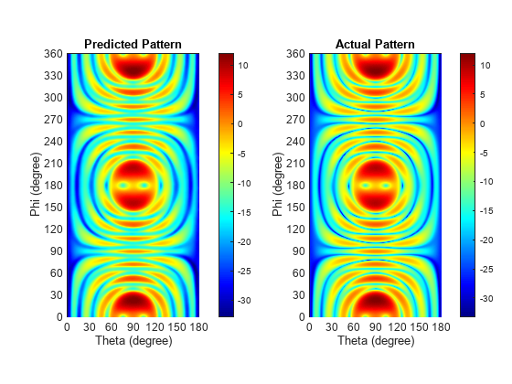
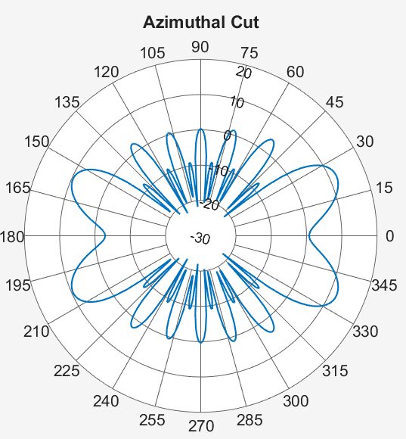
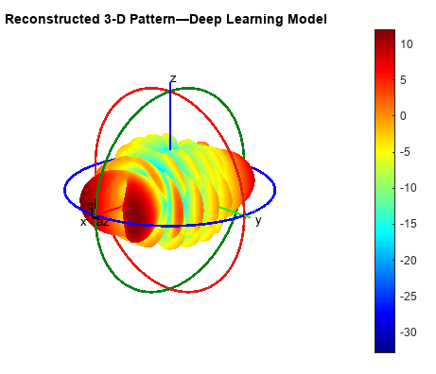
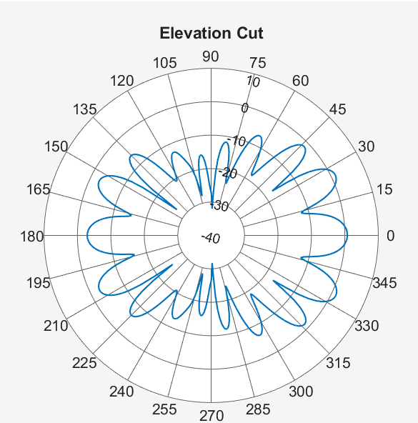
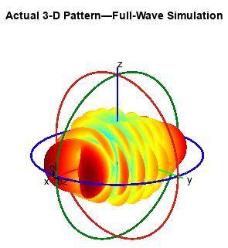
Pattern Reconstruction Using AI: Simulation Data Results
Reconstruct 3-D Antenna Pattern from 2-D Slices Using Deep Learning
https://www.mathworks.com/help/antenna/ug/reconstruct-3d-pattern-from-2d-slices-using-deep-learning.html
Notes:
Here you see a snapshot of an example.
On the left, the 2 orthogonal slices of a non-obvious antenna pattern, and a pattern that was not used to train the network.
On the middle, the 3 D pattern: on the bottom the original results, on top the reconstructed results.
And on the right hand side the difference between the two.
As you can see the quality of the reconstruction is excellent, nit only from a numerical perspective but also from a perception, feature based point of view.

Slide 13
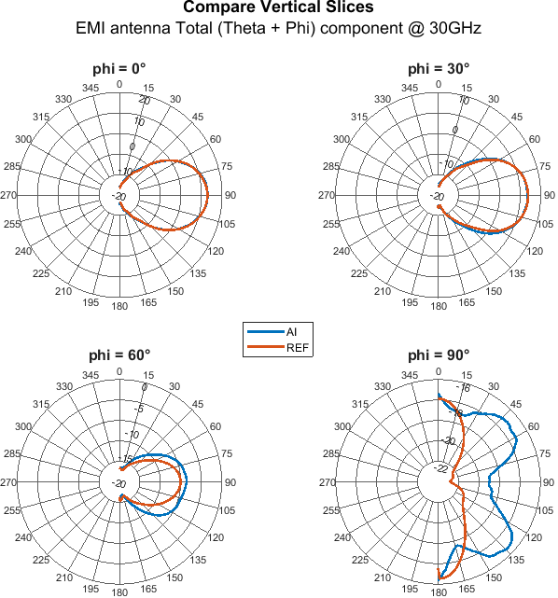
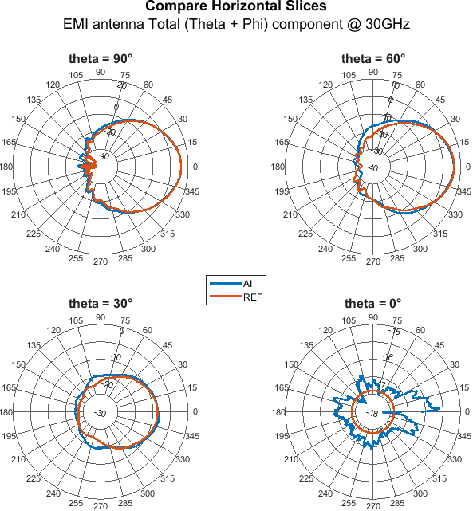
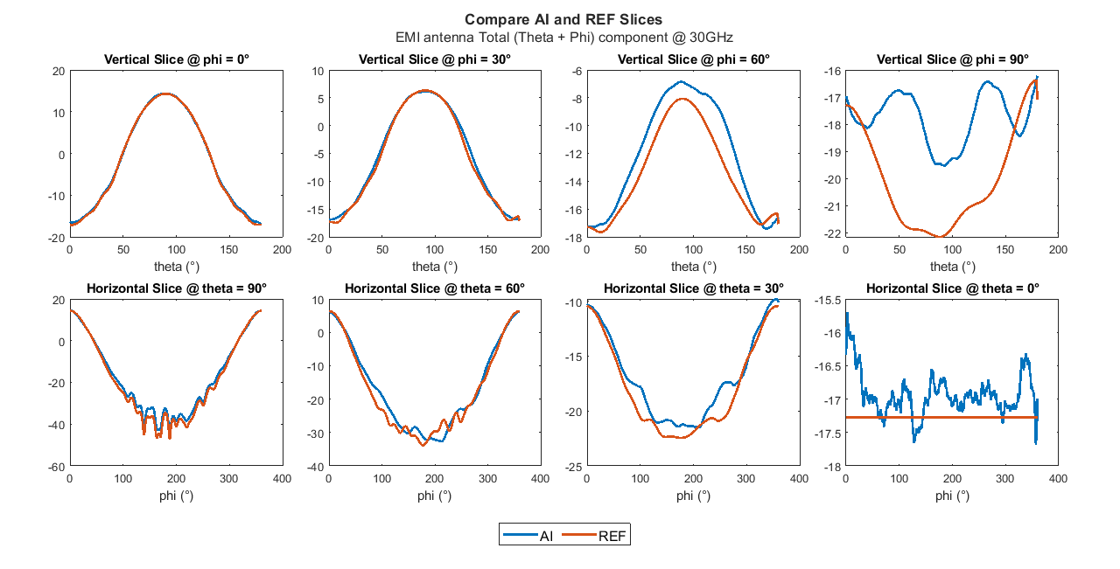
Pattern Reconstruction Using AI: Measured Data Results Collaboration with Rohde&Schwarz
Unique commercial AI-based model to reconstruct diverse antenna pattern types
Reconstruct 3D pattern from sparse data (~ 1% of full pattern data) with low RMSE and high SSIM
Small model size – 30 MB
Fast inference times of ~ <= 1sec
Rohde&Schwarz Test Forum video: Accelerating antenna pattern analysis and simulation with MATLAB
With special thanks and acknowledgements to the work of Adam Tankielun (Rohde & Schwarz)
Notes:
And here you see another validation example, this one based on actual measurements.
This result comes from a very engaging collaboration with R&S, and I’d like to acknowledge and thank especially Adam Tankielun.
In the plots here you see the comparison between measurements and AI reconstructed pattern for an extremely wideband EMI antenna recently launched by R&S. As you can see the prediction is excellent. You see the maximum difference at the poles of the pattern where the scale is really compressed and data is noisy.
You can try patternFromAi in Antenna Toolbox today, it is a relatively small CNN model, that provides exceptionally high-quality results extremely rapidly.

Slide 14
Interactive Exercises Using MATLAB Online R2026a

Slide 15
Live Demo Using R2026b Prerelease

Slide 16
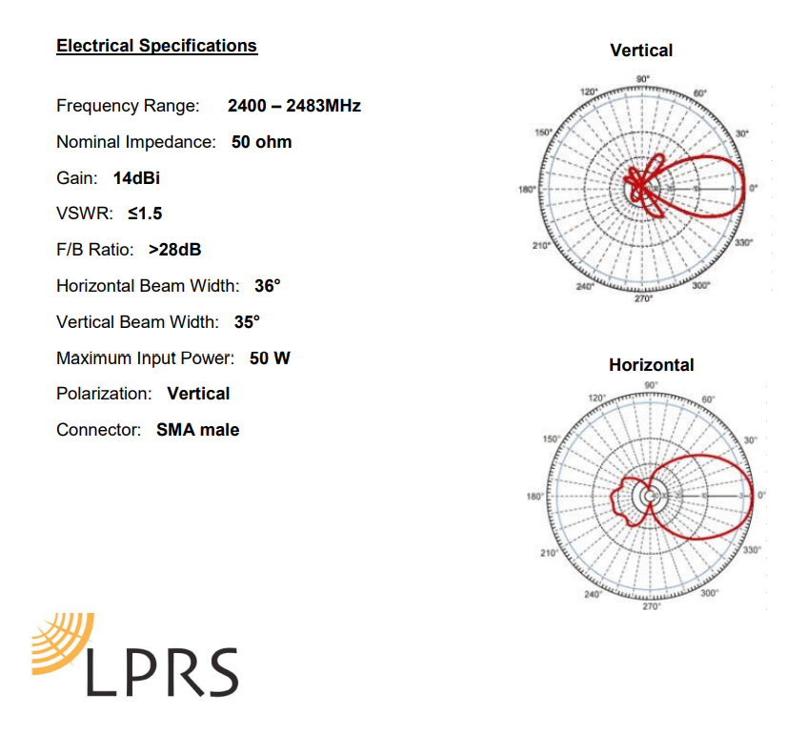
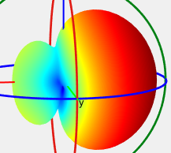
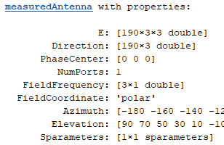
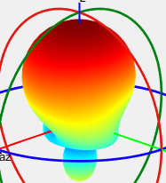
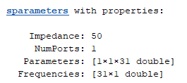
Review and 3p integration workflow:
Convert image into 2D slice data (26a)
Data sheets
3D pattern reconstruction
2d pattern slices (magnitude)
S-parameter touchstone file
patternFromAI
Measurement
2d pattern slices (magnitude)
S-parameter touchstone file
System Simulation
Read 3p file formats : ffs (25b)
Comms
Standards
3p simulations
Measured Antenna
PhasedArray
3d complex pattern data
S-parameter touchstone file
Radar
Ray Tracing
Measurement
3d complex pattern data
S-parameter touchstone file
Satcom
Notes:
Formats, coordinate systems, normalizations

